Slide 1
GALAXY : AT HAND
Parul Institute of Computer Application (PICA)
Semester 6 Mini Project – II
2020-2021
Guided By : Dr. Priya Swaminarayan & Dr. Kamini Solanki
Team Members :
Milan Jasani (180510101015)
Abhishek Mashruwala (180510101027)
Notes:
© Copyright PresentationGO.com – The free PowerPoint and Google Slides template library

Slide 2
INDEX
Abstract
Advantages of Our System
Disadvantages of Our System
Hardware Requirements & Software Requirements
Features
Users and its short description
Modules and their description
Timeline Chart
Technologies Used In Our System
DFD
Use Case
Activity Diagram
ER Diagram
Flow Chart
Data Dictionary
Development Phase - 1
Development Phase - 2
Development Phase - 3
Development Phase – 4
Future Enhancement
Reference & Bibliography

Slide 3
ABSTRACT
Search engine optimization is a strategical technique to take a web document in top search results of a search engine.
In addition, most of other search engines use Google search patterns so we have concentrated on it.
This is like a Search Engine, where you can search for any type stuff used in programming, like Git, Stack Overflow, Erorr, Modules, etc.
Other than this it has plenty of other features.
Notes:
© Copyright PresentationGO.com – The free PowerPoint and Google Slides template library

Slide 4
ADVANTAGES OF OUR SYSTEM
Best for python programmers.
Show only less than or equal to 50 relevant links.
Many helpful widgets like calculator, translator and many more.
No false information.
Advertisement free.

Slide 5
DISADVANTAGES OF OUR SYSTEM
We are not using proper web scrapping. Not all information is provided.
Not our own web page screen.

Slide 6
HARDWARE REQUIREMENTS
Processor : Processor Intel(R) Core (TM) i3 CPU @ 2.10GHz, 2.10GHz
Memory: 256 MB
Hard Disk : 160 GB
Device : Keyboard, Mouse

Slide 7
SOFTWARE REQUIREMENTS
Anaconda or Python 3.8 or PyCharm
SQLite 3

Slide 8
FEATURES
Text To Speech
Time
Day and Date
Calculator
Calendar
Translator
Make Web Search
Random Python Facts
See The History
Offline Game
Back
Refresh
Fetch Any Website
Search In GitHub
Search In Stack overflow
Search For Any Error
Search For Any Module
Make Google Search
Get Results Sorted By Most Visited Sites
Exit

Slide 9
USER MODULES
PROGRAMMER
USER

Slide 10
DESCRIPTION OF USER MODULES
Programmer: Programmer is the person who have developed this system. Programmer also handles the sites and make sure that the system works smoothly without any errors.
User: The basic goal of a user is to obtain information relevant to their inquiry.

Slide 11
SYSTEM MODULES
Text To Speech
Translator
Time
Day and Date
Calculator
Offline Game
See History
Programmer Search Area
Refresh
Exit
Calendar

Slide 12
DESCRIPTION OF USER MODULES
Text To Speech: In this module the system will convert the text to speech. For example if the system displays some text then the system will speak it loud.
Time: In this module the system will speak out the time.
Day and Date: In this module the system will speak out the day and date.
Calculator: In this module users can scientific calculations like addition, subtraction and much more.
Calendar: In this module user can go through the calendar.

Slide 13
CONTINUE…
Translator: In this module, the user can translate any phrase or word between English and over 100 languages.
Offline Game: If the user is offline, that means if the user does not have working network can he/she can enjoy play game on the system.
See History: In this module, the user can go through their past history.
Programmer Search Area: This module is specially designed for programmers. Programmer can search for any query or errors. We will be redirected to some top pages like Stack Overflow.

Slide 14
CONTINUE…
Refresh: If any module gets stuck, then this module will help it to reload it again.
Exit: If the user is done with his work, then he/she can exit from system.

Slide 15
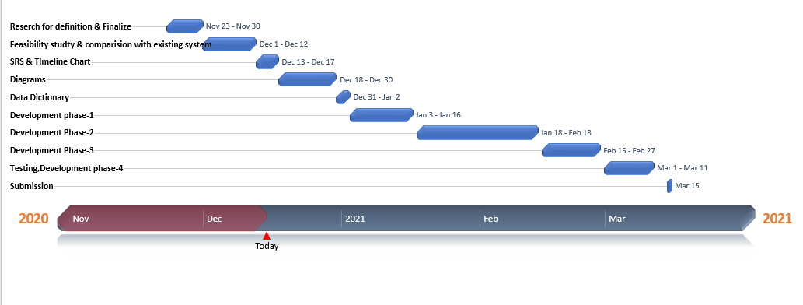
TIMELINE CHART

Slide 16
TECHNOLOGIES USED IN OUR SYSTEM
Python
Web Scrapping
File Handling
Tkinter for GUI
Database Management (SQLite)
Text To Speech

Slide 17
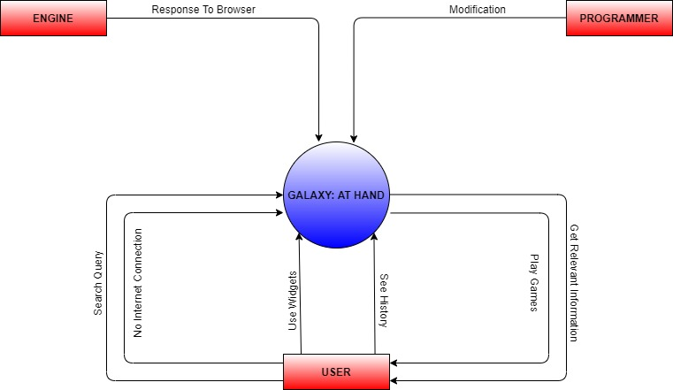
CONTEXT/ZERO LEVEL DFD

Slide 18
PROGRAMMER LEVEL 1 DFD

Slide 19
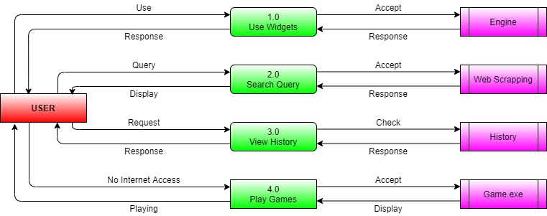
USER LEVEL 1 DFD

Slide 20
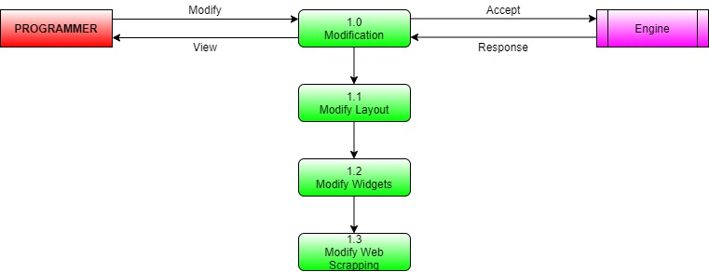
LEVEL 2 DFD
As shown in the figure PROGRAMMER is the external entity. Here we are analyzing the process “Modification” of the level 1 DFD.

Slide 21
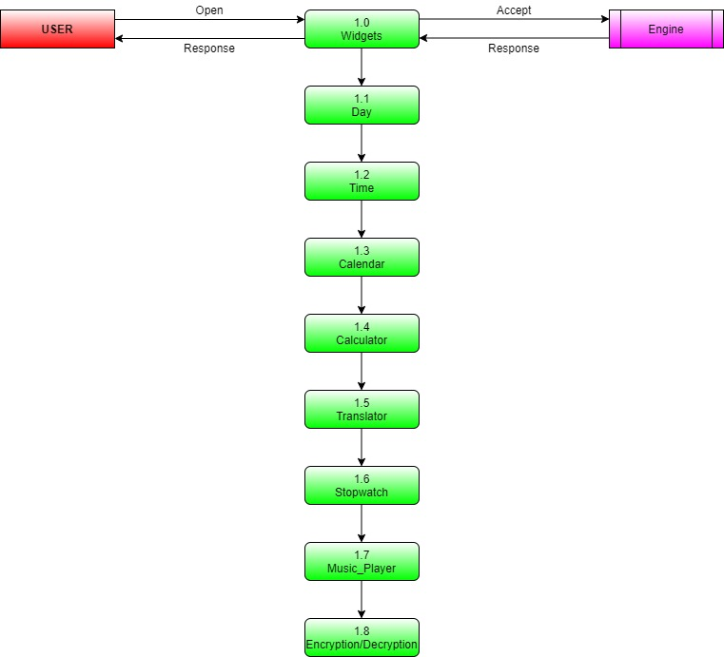
LEVEL 2 DFD
As shown in the figure USER is the external entity. Here we are analyzing the process “Use Widgets” of the level 1 DFD.

Slide 22
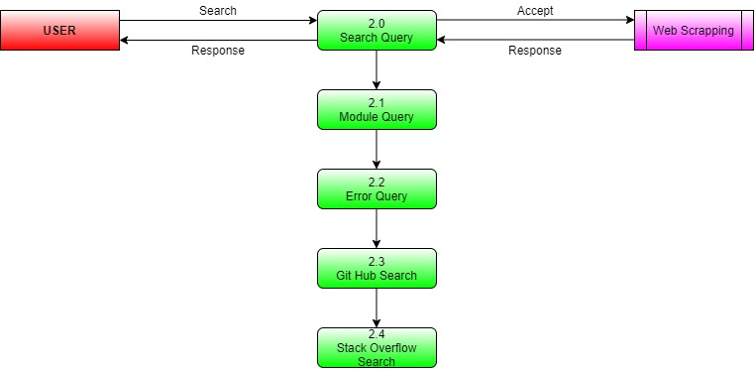
LEVEL 2 DFD
As shown in the figure USER is the external entity. Here we are analyzing the process “Search Query” of the level 1 DFD.

Slide 23
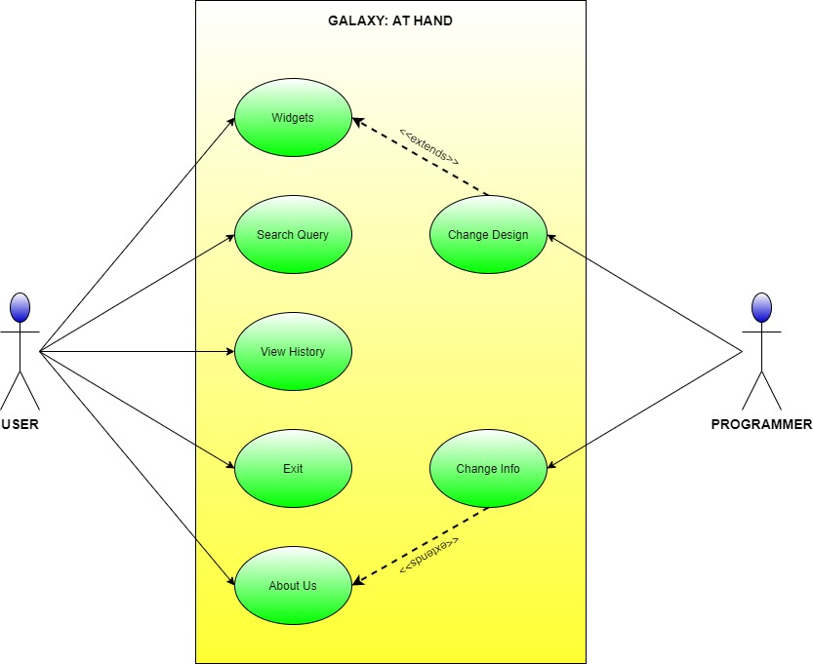
USE CASE DIAGRAM

Slide 24
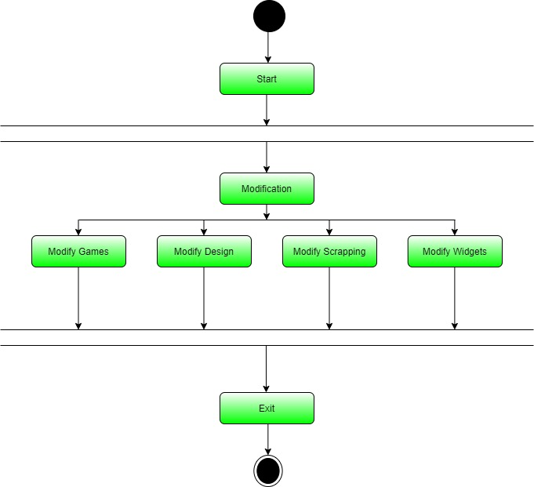
PROGRAMMER ACTIVITY DIAGRAM

Slide 25
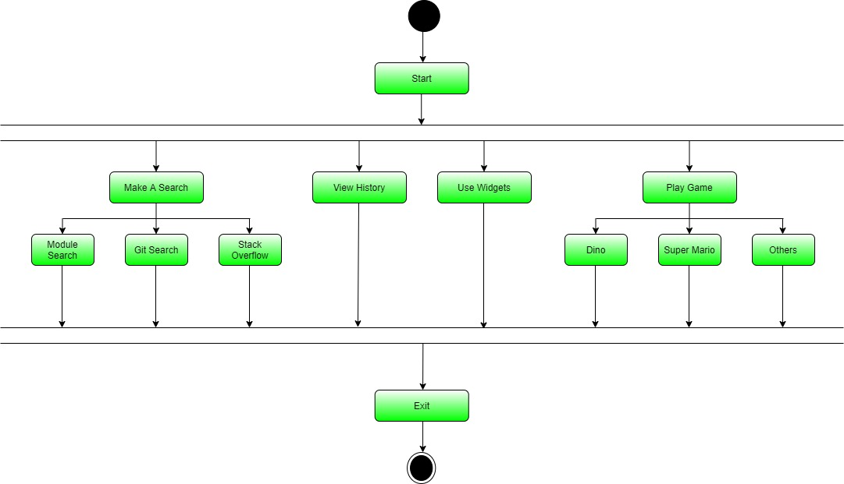
USER ACTIVITY DIAGRAM

Slide 26
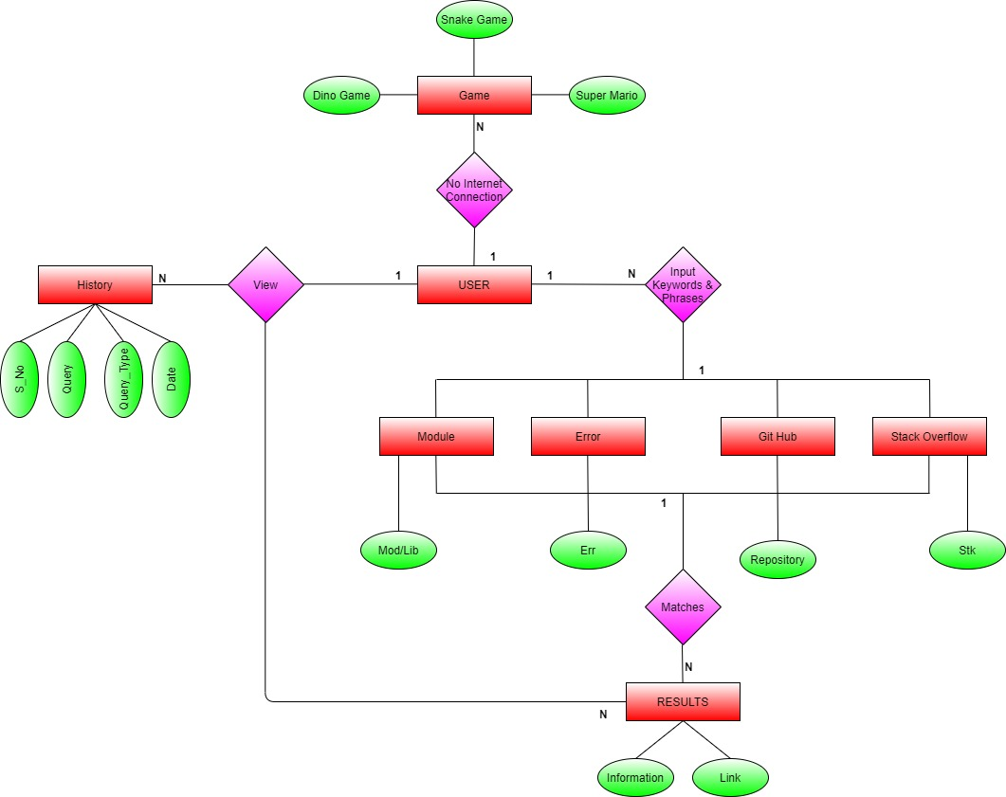
ER DIAGRAM

Slide 27
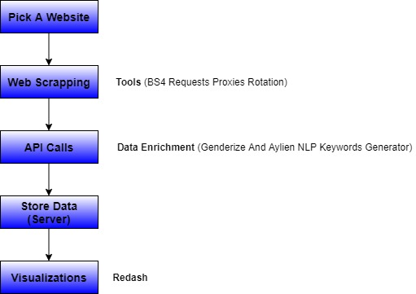
FLOWCHART
Web Scrapping Flow Chart

Slide 28
DATA DICTIONARY
History
Sr. No. | Field Name | Type | Size | Description | Constraint | Example
1 | S_No | Int | 5 | Serial Number | PRIMARY KEY | 1
2 | Query | Char | 15 | Query Like Error | NOT NULL | Syntax Error
3 | Query_Type | Char | 5 | Show Type of Query Searched | NOT NULL | Err, None
4 | Date | Date | 10 | Date of Search | NOT NULL | 02/01/2020

Slide 29
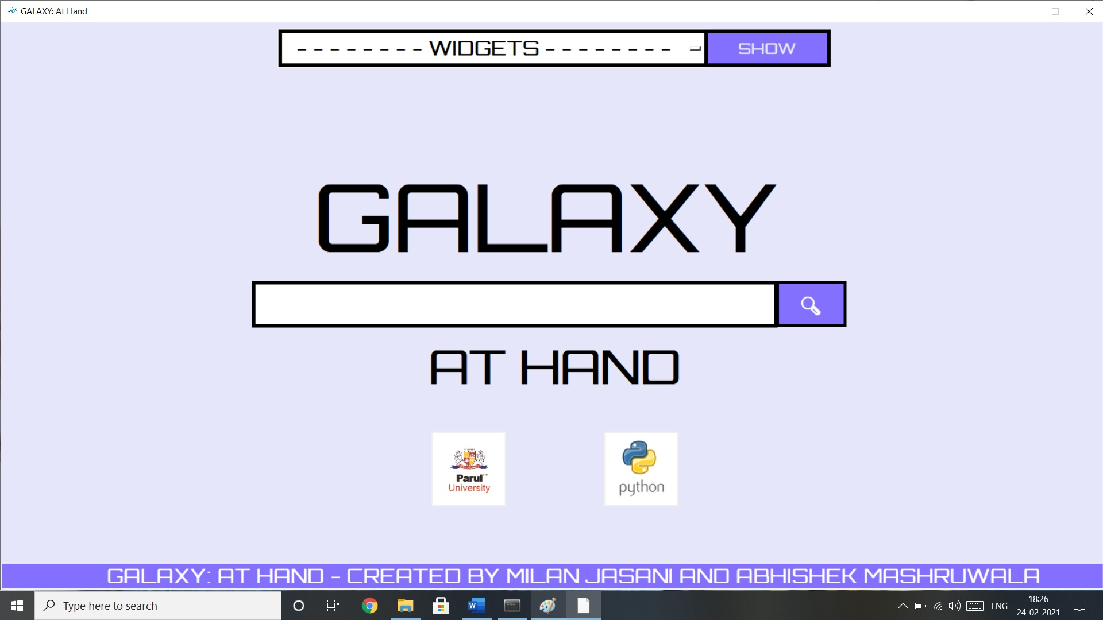
SYSTEM DEVELOPMENT PHASE 1
Home Page

Slide 30
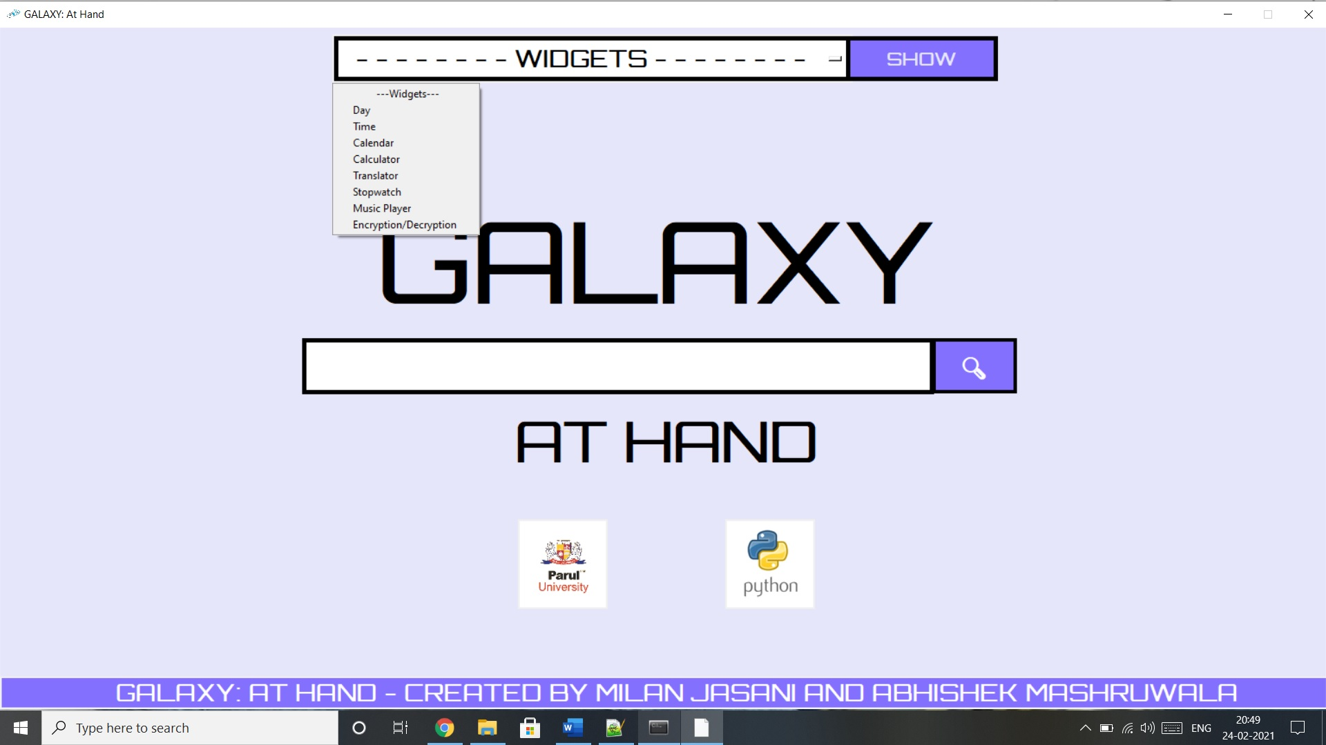
SYSTEM DEVELOPMENT PHASE 1
Widgets List

Slide 31
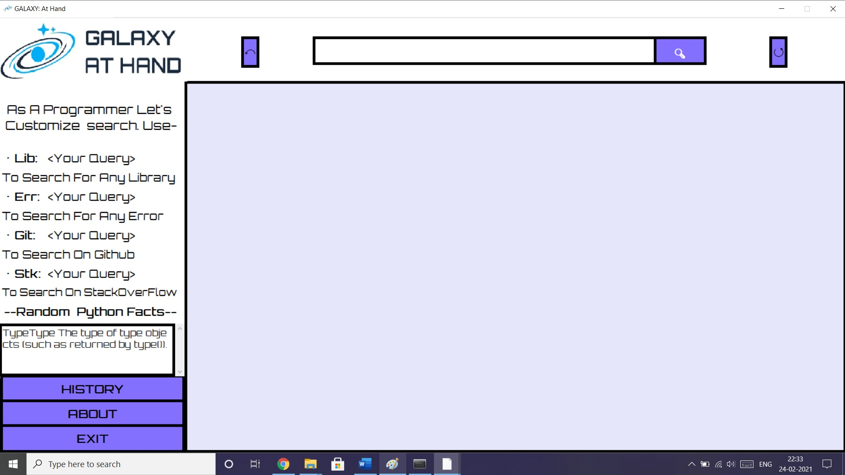
SYSTEM DEVELOPMENT PHASE 1
Search Home Screen

Slide 32
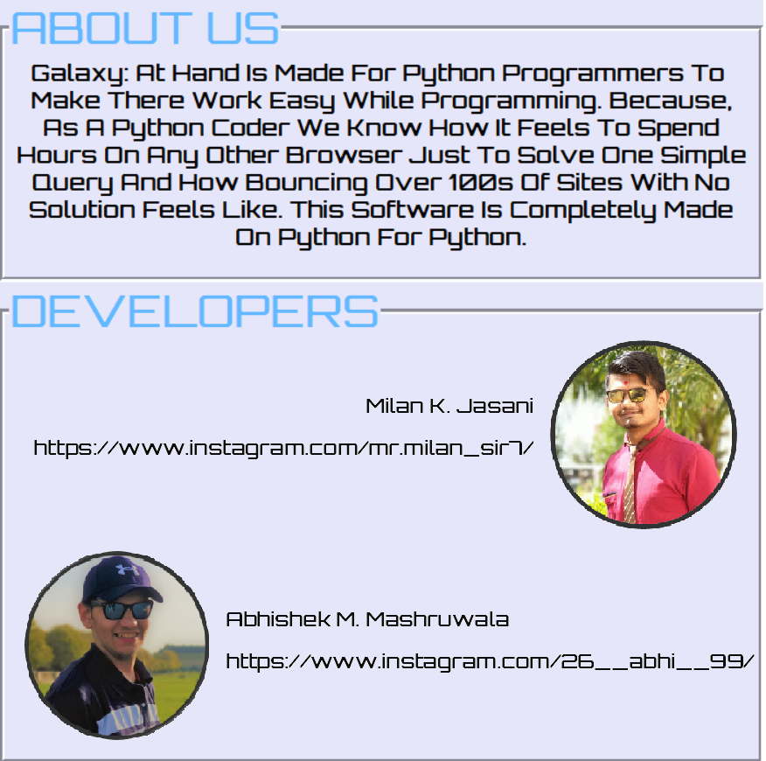
SYSTEM DEVELOPMENT PHASE 1
About Us

Slide 33
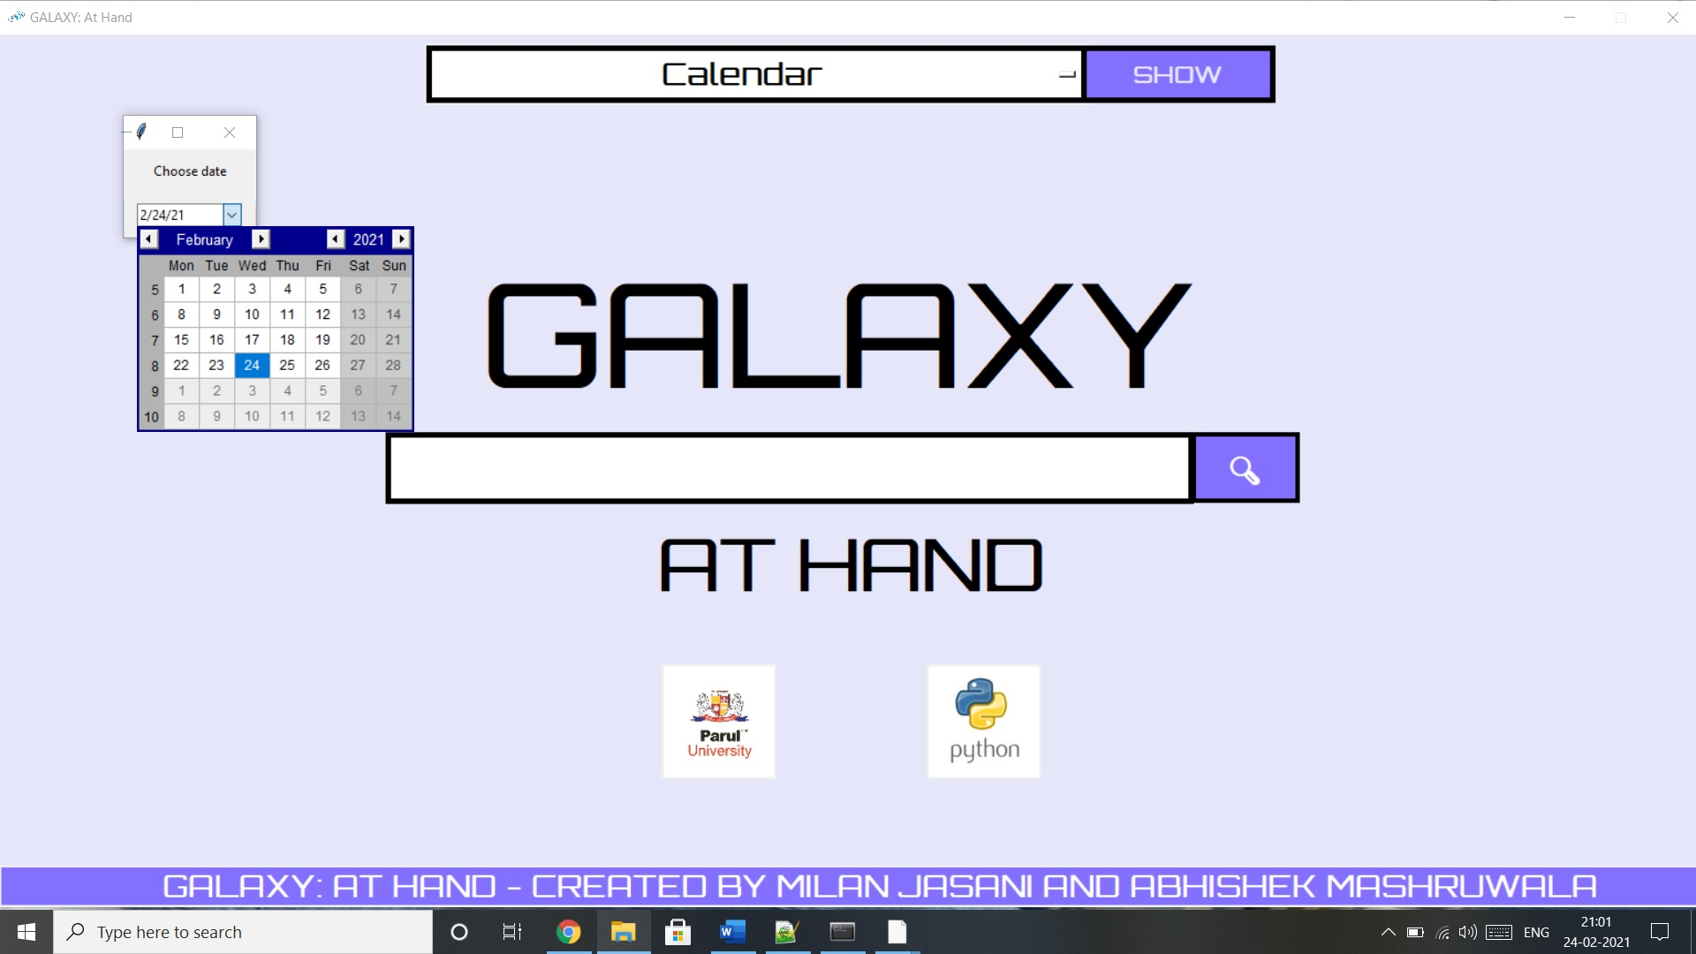
SYSTEM DEVELOPMENT PHASE 2
Calendar (Widget)

Slide 34
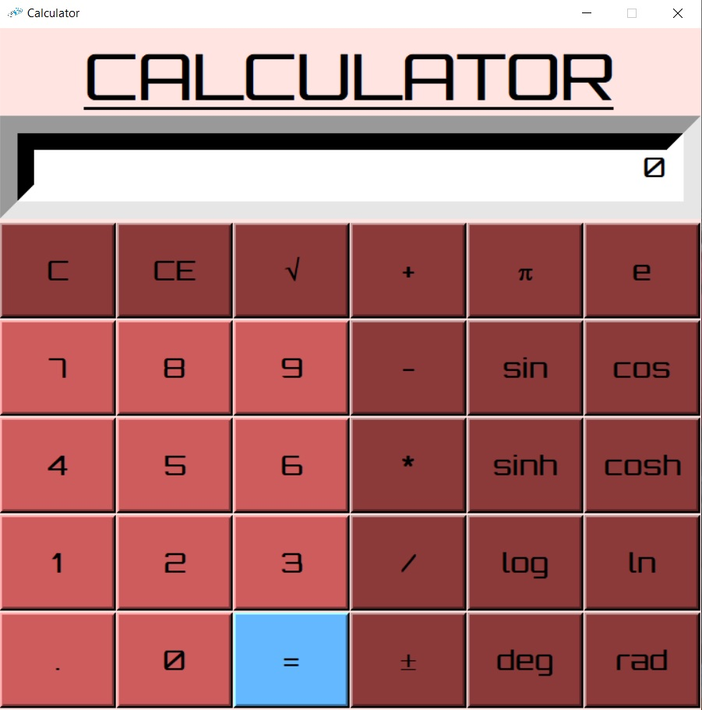
SYSTEM DEVELOPMENT PHASE 2
Calculator (Widget)

Slide 35
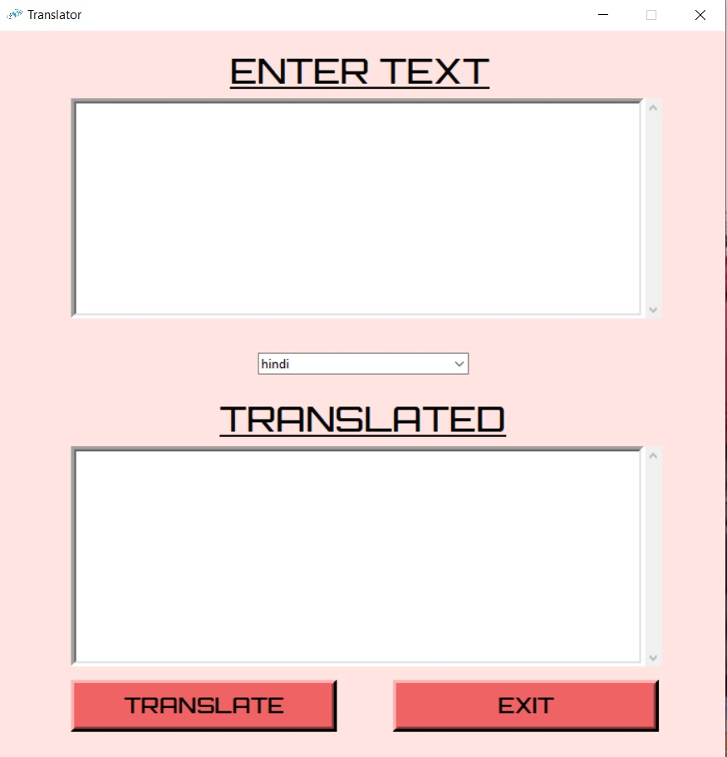
SYSTEM DEVELOPMENT PHASE 2
Translator (Widget)

Slide 36
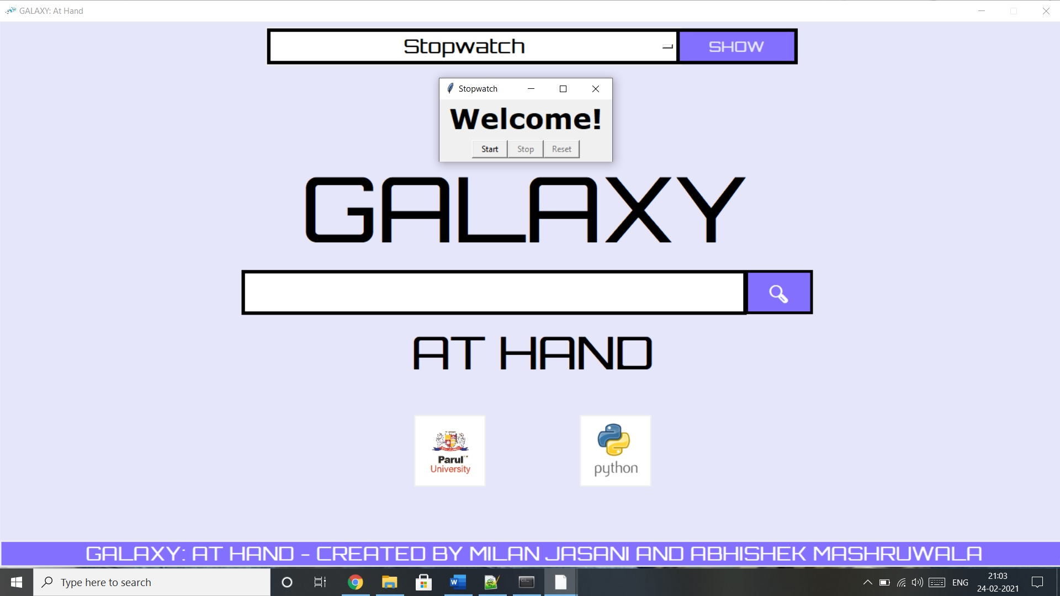
SYSTEM DEVELOPMENT PHASE 2
Stopwatch (Widget)

Slide 37
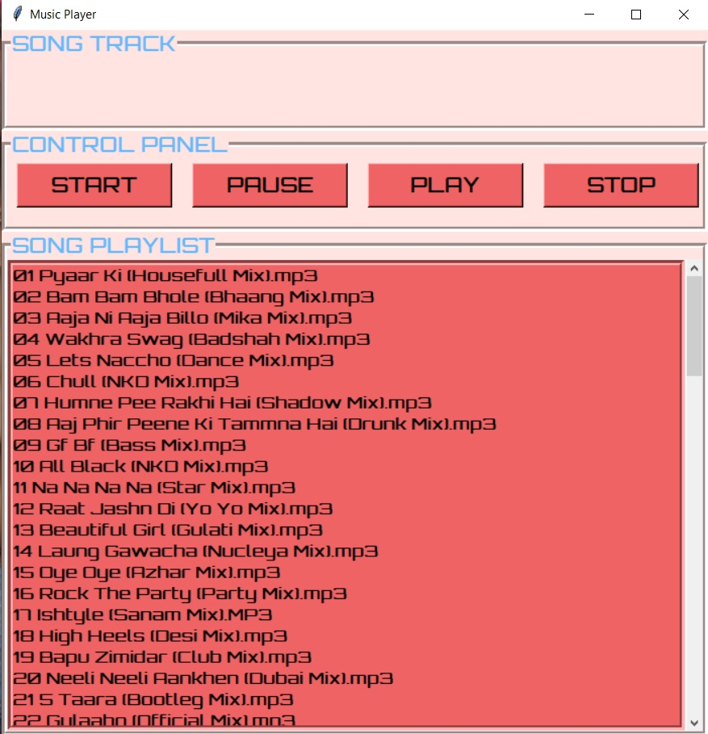
SYSTEM DEVELOPMENT PHASE 1
Music Player (Widget)

Slide 38
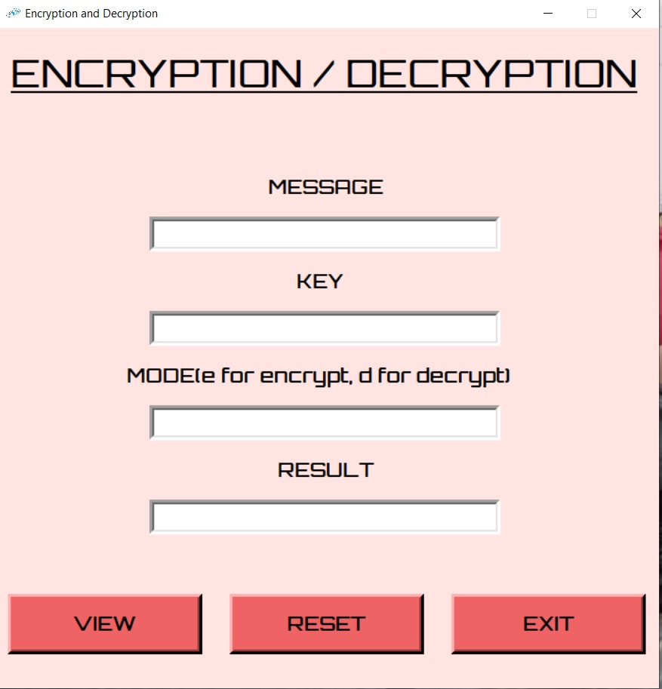
SYSTEM DEVELOPMENT PHASE 1
Encryption/Decryption (Widget)

Slide 39
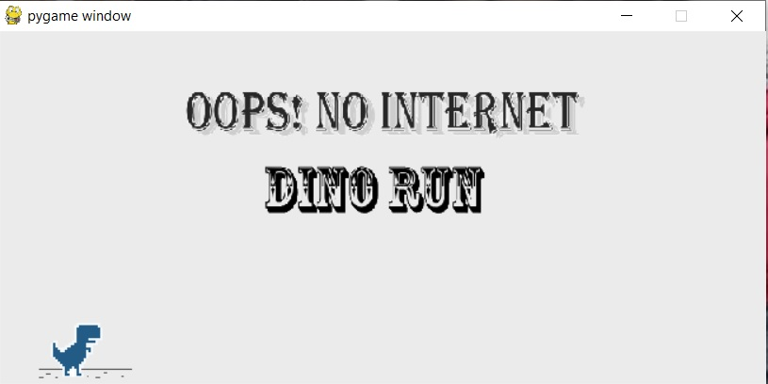
SYSTEM DEVELOPMENT PHASE 3
Dino Game

Slide 40
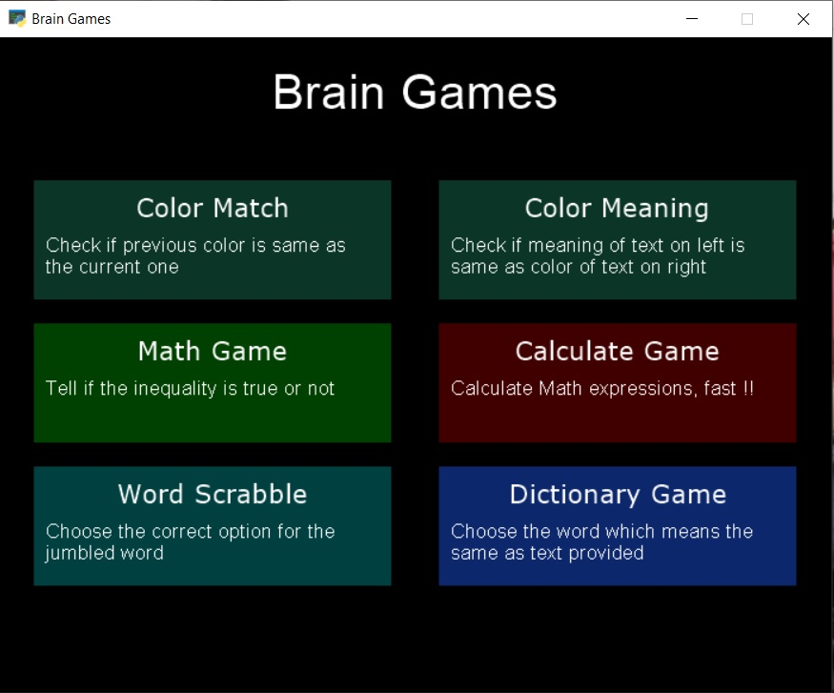
SYSTEM DEVELOPMENT PHASE 3
Brain Games Home Screen

Slide 41
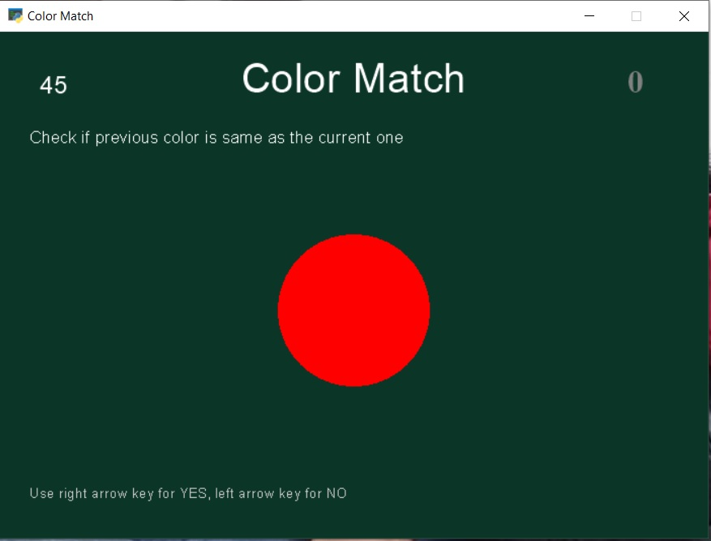
SYSTEM DEVELOPMENT PHASE 3
Color Match (Brain Games)

Slide 42
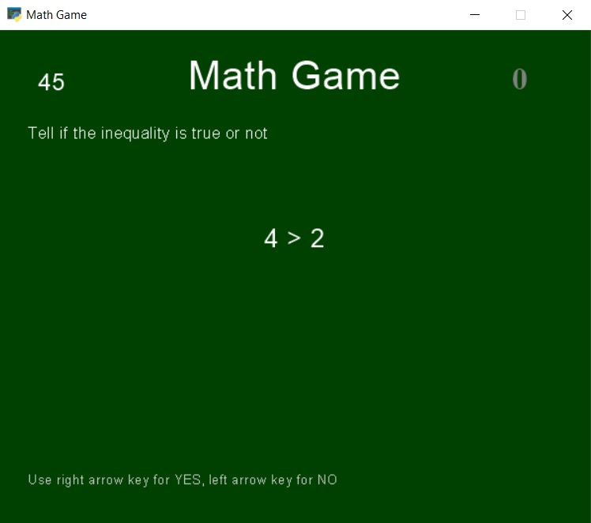
SYSTEM DEVELOPMENT PHASE 3
Math Game (Brain Games)

Slide 43
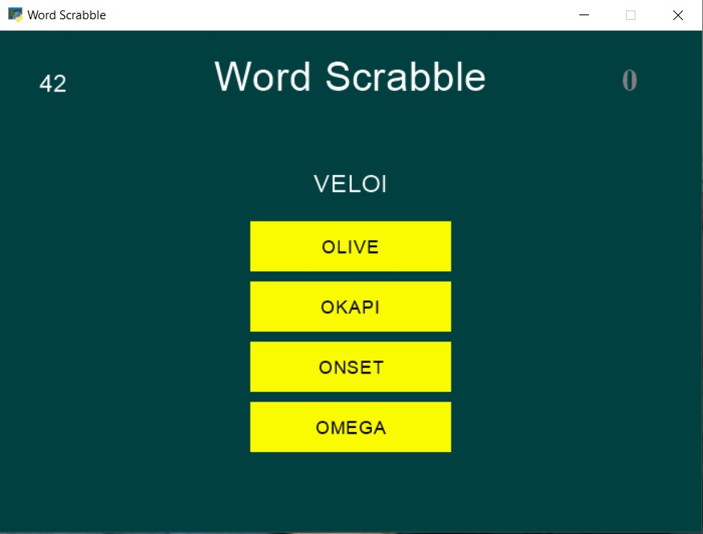
SYSTEM DEVELOPMENT PHASE 3
Word Scrabble (Brain Games)

Slide 44
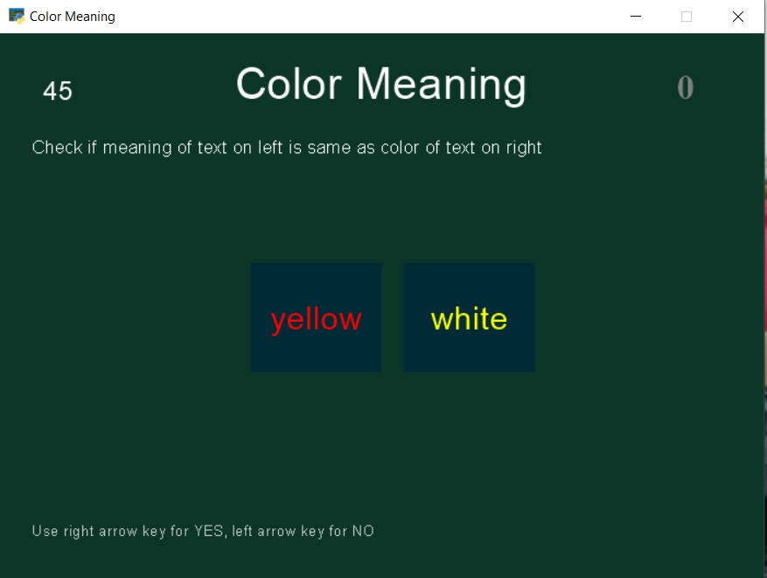
SYSTEM DEVELOPMENT PHASE 3
Color Meaning (Brain Games)

Slide 45
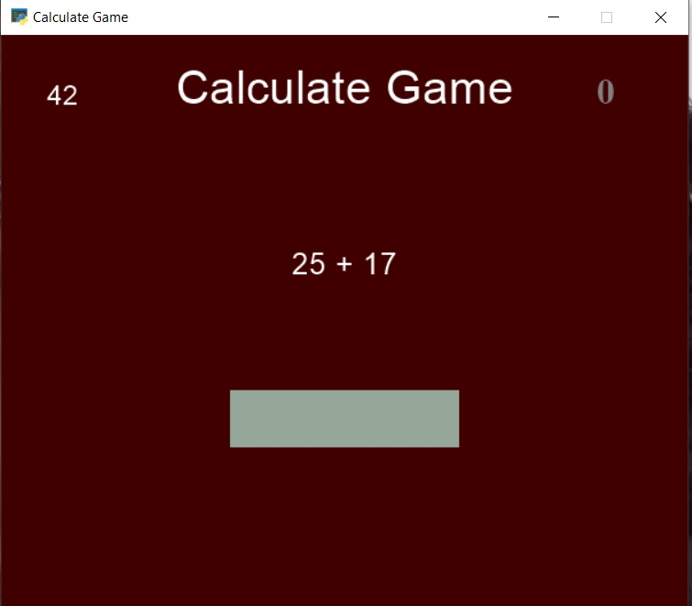
SYSTEM DEVELOPMENT PHASE 3
Calculate Game (Brain Games)

Slide 46
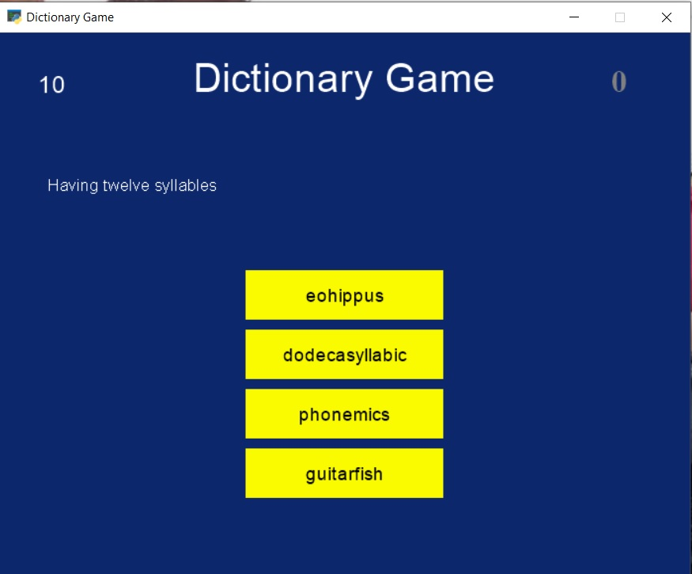
SYSTEM DEVELOPMENT PHASE 3
Dictionary Game (Brain Games)

Slide 47
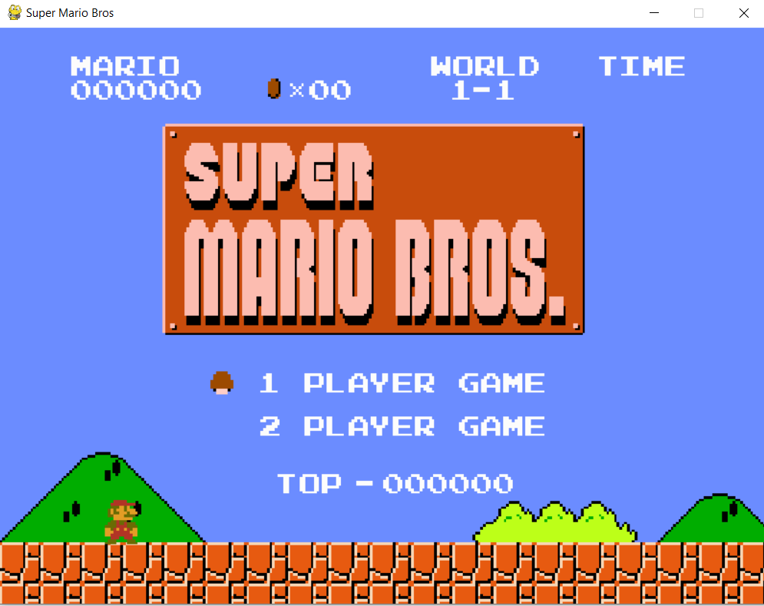
SYSTEM DEVELOPMENT PHASE 3
Super Mario Game

Slide 48
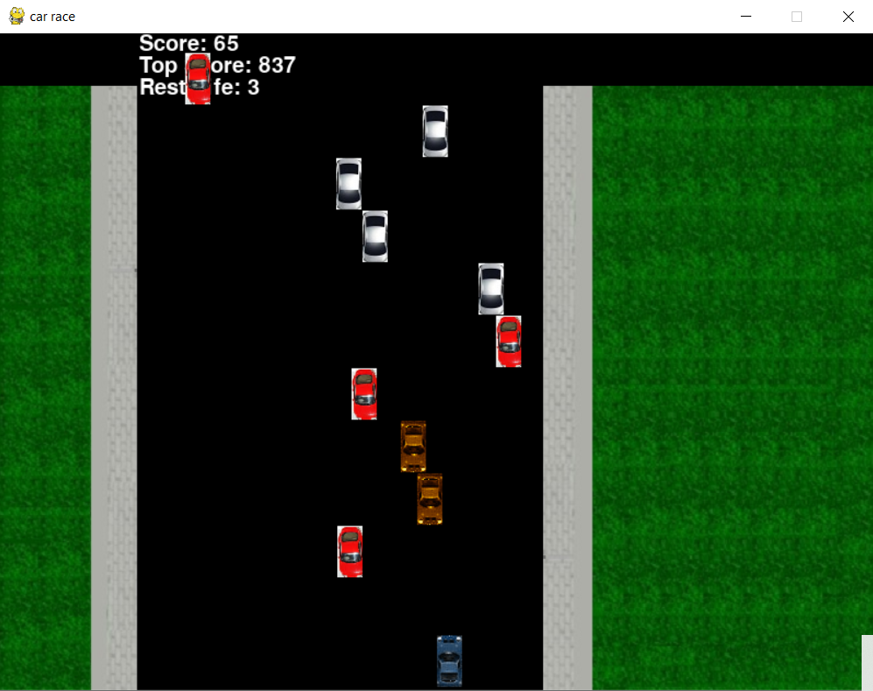
SYSTEM DEVELOPMENT PHASE 3
Car Game

Slide 49
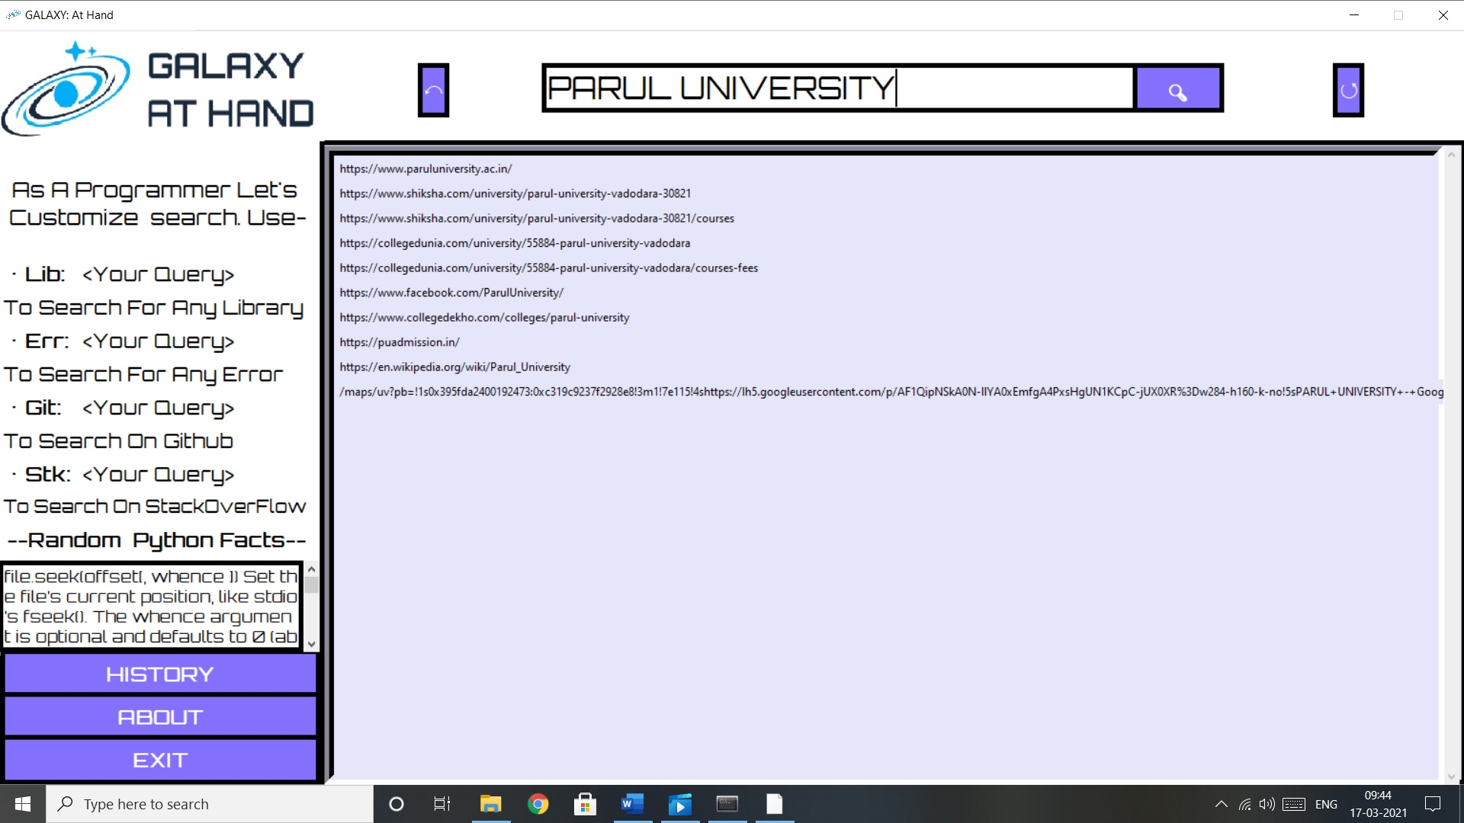
SYSTEM DEVELOPMENT PHASE 4
Search Results

Slide 50
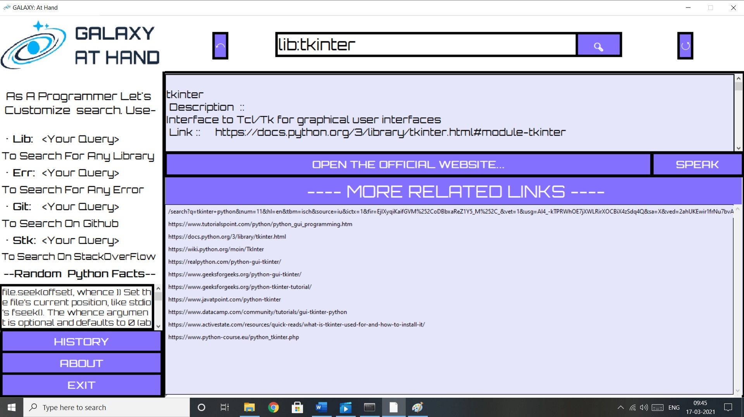
SYSTEM DEVELOPMENT PHASE 4
Library Search

Slide 51
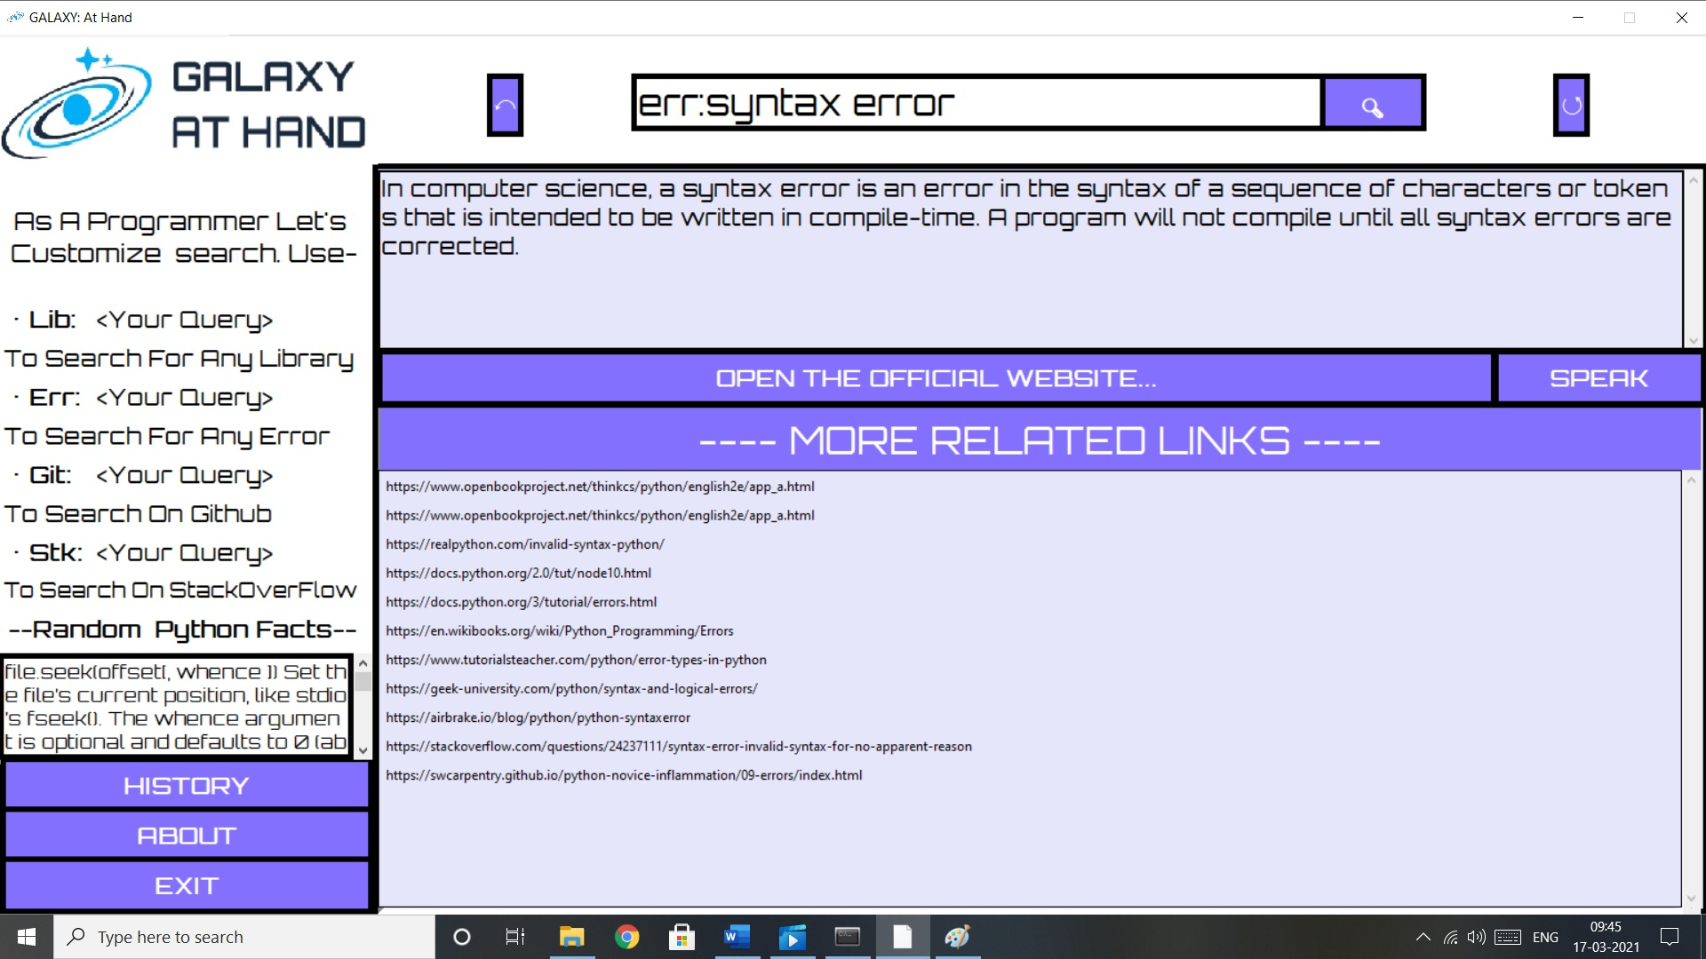
SYSTEM DEVELOPMENT PHASE 4
Error Search

Slide 52
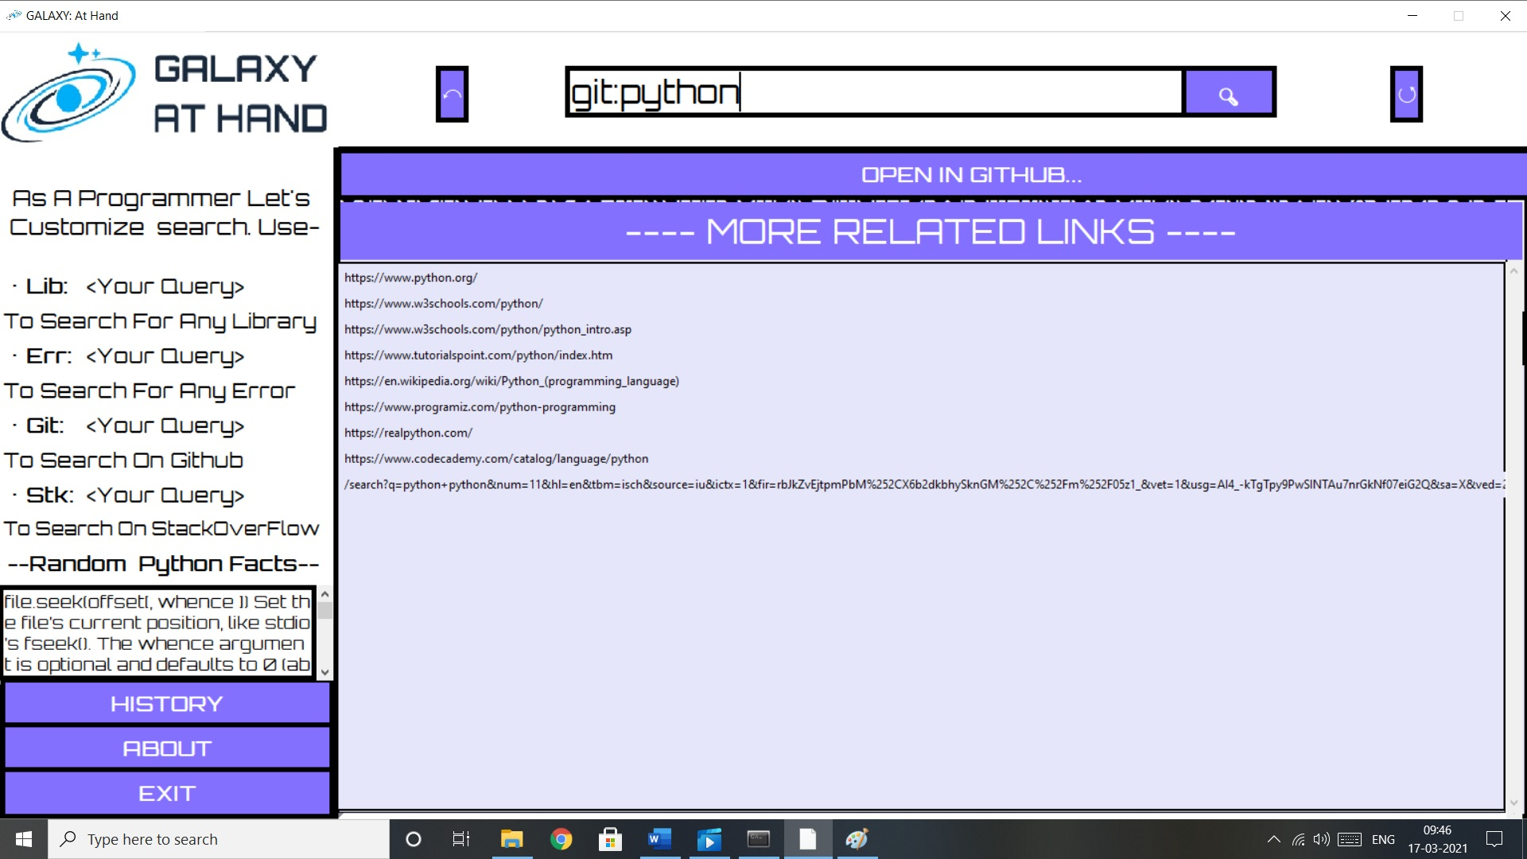
SYSTEM DEVELOPMENT PHASE 4
Git Hub Search

Slide 53
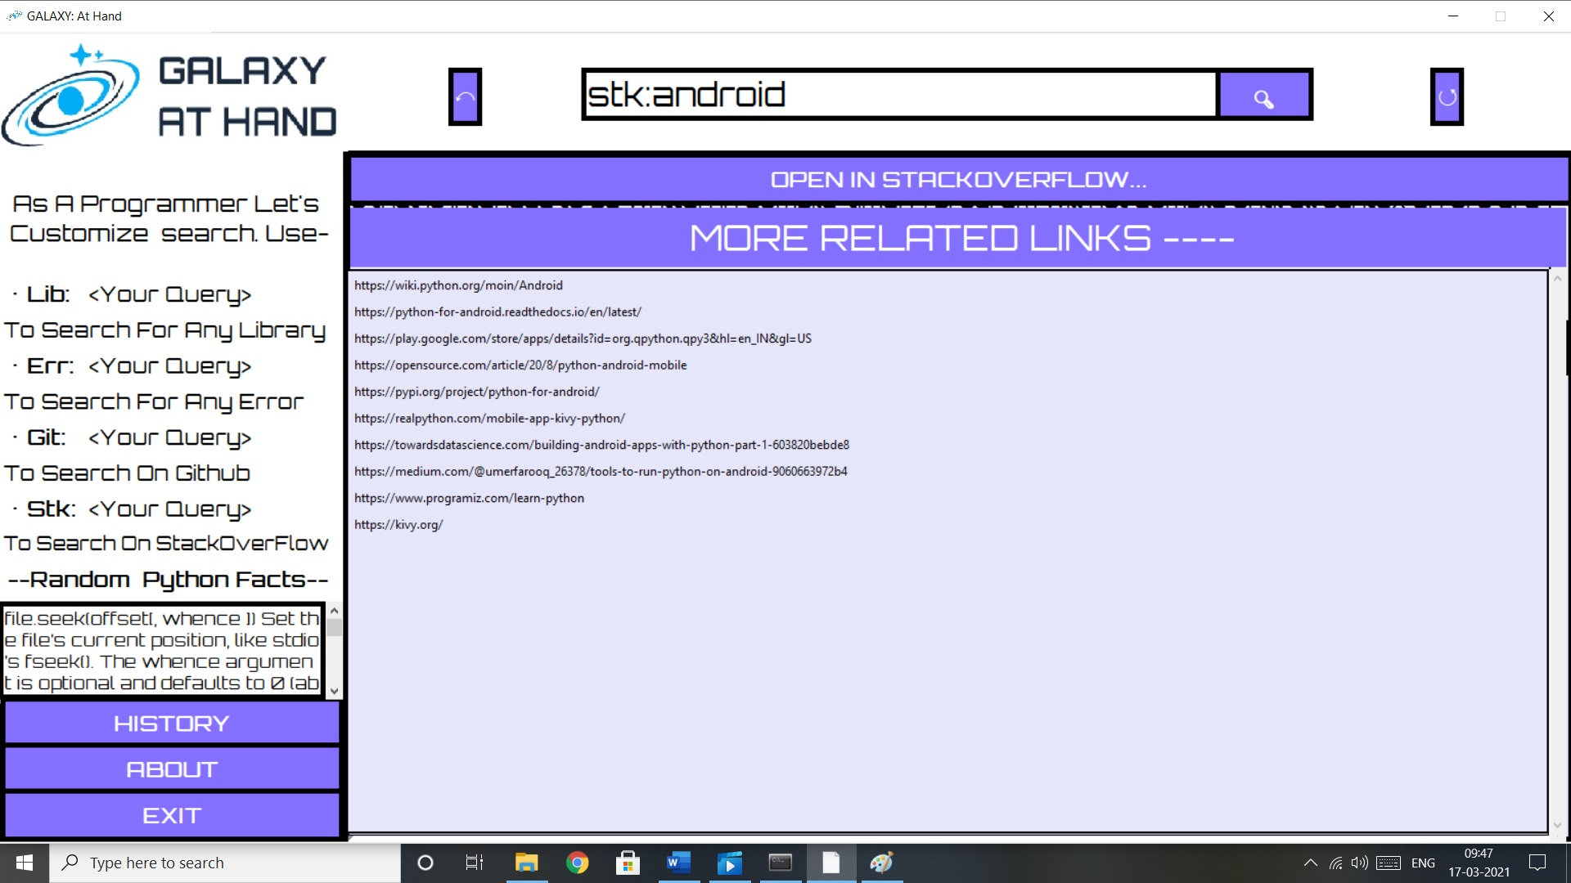
SYSTEM DEVELOPMENT PHASE 4
Stack Overflow Search

Slide 54
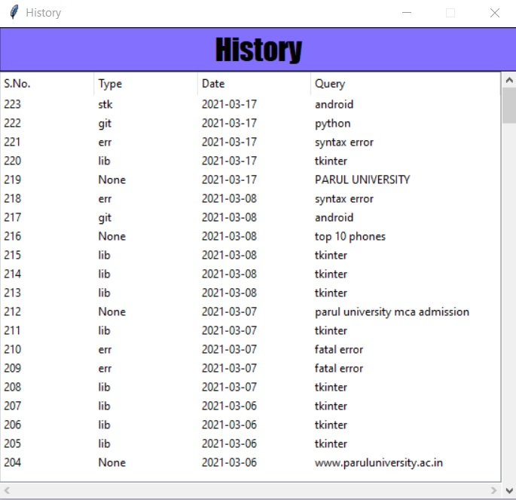
SYSTEM DEVELOPMENT PHASE 4
History

Slide 55
FUTURE ENHANCEMENT
In the near future we will be with more search results that will include images, videos, news, shopping and much more.
The application can be further available for smartphones devices such as android and IOS.
Can improve the security level and making the application more secure and reliable.
Project can be upgraded to more advance option while doing filtering the result, such as sort date wise, location wise etc.

Slide 56
REFERENCES AND BIBLIOLOGY
References
www.youtube.com
www.w3school.com
www.tutorialpoint.com
www.geeksforgeeks.com
www.code-reference.com
www.stackoverflow.com
www.github.com
Bibliology
Python 3rd Edition

Slide 57
Thank You!
Notes:
© Copyright PresentationGO.com – The free PowerPoint and Google Slides template library

